Slide 1
Since July 2020, searches in LAB have 33% overall exit rate, averaging ~12k searches per month
Searches/Sessions
Exit Rate
35%
36%
Jul-20
Aug-20
Sep-20
Oct-20
Nov-20
Dec-20
Jan-21
Feb-21
Mar-21
Apr-21
May-21
Jun-21
Searches
Search Exit Rate
Source: Google Analytics site data for lab.bcg.com

Slide 2
2021 People Survey LAB functionality comments
Main Messages
Search/finding content testimonials
Too much content and hard to search/find what I'm looking for (17/26) 64%
Issues with the Content structure / format (6/26) 24%
Friction with LAB courses / usability (3/26) 12%
I find it extremely difficult to find LAB courses since the new platform went live
I can sometimes take advantage of these resources, though it's difficult to search and find the ones that are going to provide real value and are specific to what I'm looking for
Sometimes a bit hard to navigate through enormous offering at LAB
The online learning platform is very hard to navigate and find the right topics.
LAB has become difficult to navigate or search making it a frustrating experience. When you find the training you are looking for, the content and training is very good.
There's just too much and I find it all hard to navigate. I often end up deferring because it seems like it would take too long to explore all the options.
Too hard to find and disorganized
I find the primers hard to locate
Source: 2021 People Survey comments

Slide 3
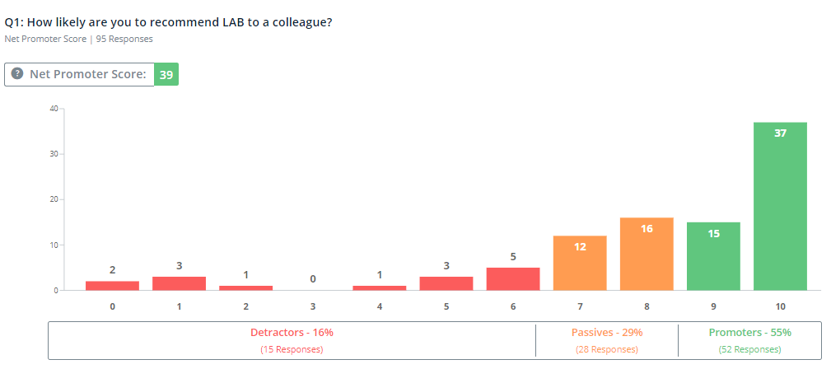
LAB NPS feedback received since May 2021 – 2 comments received from detractors are search related
NPS Score
Search Comments
User interface is visually unattractive: old-fashioned, too full, no clear overview of what you're going to find where; navigation is not user friendly: too many clicks to register to a course that will never show complete even if you did complete it; search function is inefficient and yields too many results even after refining it to the maximum and keywords don't even work… (User NPS rating: 1)
I don't find the stuff I am looking for (User NPS rating: 2)
Great experience, easy to find trainings and to join classes (User NPS rating: 10)
N = 95, of 95 NPS survey responses received 11 comments (optional) of which 3 are search related

